Slide 1
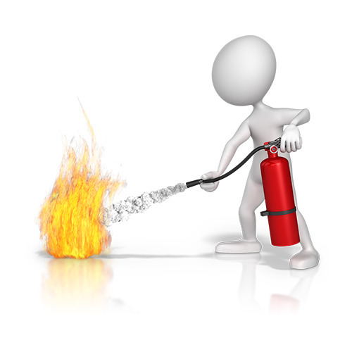
Fire Safety
Frame Type: <Animation>
Frame no.: <0>
Visulisation notes:
1. Show the text in the frame on after other
2. Blur the frame back
Functionality instructions:
1. Show the fire extinguisher spraying
2.
Objective
After studying this topic, you will be able to:
To familiarise the target group for working in teams.
Target Group
This course will be designed for all employees working in teams.

Slide 2
Fire Safety
Frame Type: <Animation>
Frame no.: <0>
Visulisation notes:
1. Show the three button
2.
Functionality instructions:
1. Create three button to view the content in each module
2.
Module 1
Fire Safety
Module 2
Manual Handling
Module 3
Safeguarding
Click on each module to know more
Notes:
Audio Notes: Click on each module to know more

Slide 3
Fire Safety
Why is fire safety important?
Frame Type: <Animation>
Frame no.: <0>
Visulisation notes:
1. Show the button
2.
Functionality instructions:
1. Provide Click button on module
2.
Module on Fire safety
Notes:
Audio Notes: Click on the module to know more

Slide 4
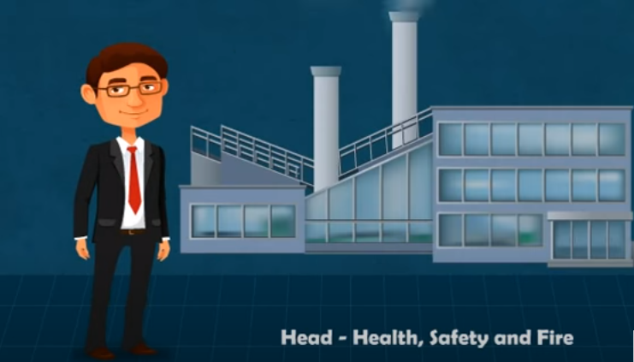
Fire Safety
Why is fire safety important?
Frame Type: <Animation>
Frame no.: <1>
Visulisation notes:
1. After showing ABC Company’s logo at the beginning, show a office premises and the man showing the premises
2.
Functionality instructions:
1. Move the screen according to the template provided with the man
2. Man should show the lip movement
<Content + Visual Area>
Notes:
Audio Notes: Ram works as head health safety and fire in a leading manufacturing company he is responsible for training the company's workforce on health and safety aspects

Slide 5
Fire Safety
Why is fire safety important?
Frame Type: <Animation/Interactive/Video>
Frame no.: <1-2>
Visulisation notes:
1. Show the text on the frame on after other ; Highlight the text according to the voice synchronization.
2. Blur the frame back
Functionality instructions:
1. Text should come after the other
2.
<Content + Visual Area>
Learning Goals
To teach the importance of Fire Safety
What are the common causes of Fire
To understand fire prevention measures from a company and individual perspective
To identify actions on discovering a fire
To recognize safe egress from the building
To understand what basic firefighting involves
Notes:
Audio Notes: To teach the importance of Fire Safety
What are the common causes of Fire
To understand fire prevention measures from a company and individual perspective
To identify actions on discovering a fire
To recognise safe egress from the building
To understand what basic firefighting involves

Slide 6
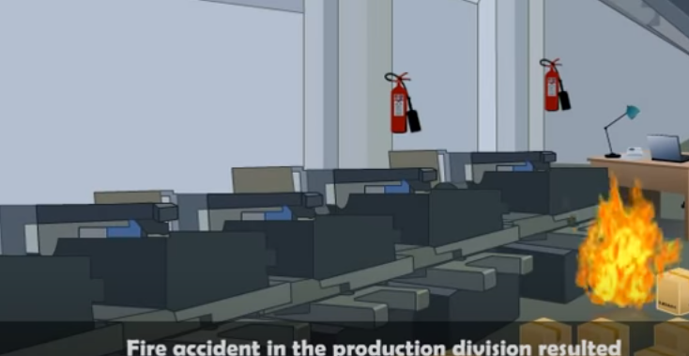
Fire Safety
Why is fire safety important?
Frame Type: <Animation>
Frame no.: <1-3>
Visulisation notes:
1. Show fire accident as shown image
2. Show the fire spread
Functionality instructions:
1. Show the fire spread in the room by blinking in small area, and spread to different parts according to voice synchronization
2. . As fire erupted show the two extinguishers blinking according to voice synchronization
<Content + Visual Area>
Notes:
Audio Notes: recently there was a fire accident in the production division that resulted in serious damage to the equipment Jim had ordered an inquiry into the accident and found that the cause of the accident was a small flash fire which erupted in a piece of machinery the safety director did concede that about once in every few days one of the machines would cause a dust explosion which is nothing but a small flash fire the machine operator has a fire extinguisher nearby and would put it off before it engulfs the entire place however in this instance the machine operator was away for lunch no one was in the vicinity causing the fire to spread in addition the area was filled with cartons and flammable material that fueled the fire increasing the damage what do you think might be the reason for this mishap is it lack of knowledge or sheer negligence on introspection Ram realized that it was neither employees were given training

Slide 7
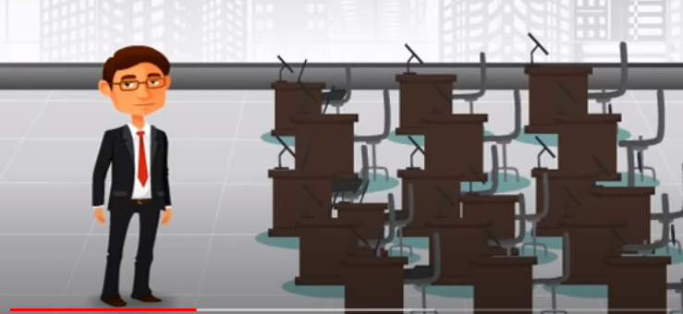
Fire Safety
Why is fire safety important?
Frame Type: <Animation>
Frame no.: <1-5>
Visulisation notes:
1. Show the Classroom setup
2.
Functionality instructions:
1. Lip movement for the character ram.
2.
<Content + Visual Area>
Notes:
Audio Notes: Ram decided to train all the 100 employees in the division on safety regulations and best practices and like most organizations chose classroom training he personally conducted a face-to-face classroom training session that lasted one full day a few sitting in the front were eagerly participating in the training session

Slide 8
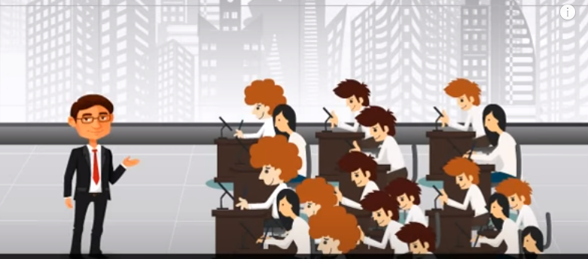
Fire Safety
Why is fire safety important?
Frame Type: <Animation>
Frame no.: <1-4>
Visulisation notes:
1. Show the employees filled in the session.
2. Show some employees face nodding head
Functionality instructions:
1. Lip movement for the character ram.
2.
<Content + Visual Area>
Notes:
Audio Notes: but that was not the case with respect to employees seated at the back of the hall he also noticed employees interest waning towards the end of the day

Slide 9

Fire Safety
Why is fire safety important?
Frame Type: <Animation>
Frame no.: <1-7>
Visulisation notes:
1. Show the idea symbol as shown in the image
2.
Functionality instructions:
1. Synchronize the audio accordingly
2. Lip movement for the character ram.
<Content + Visual Area>
Notes:
Audio Notes: Ram wondered if this exercise will have a lasting impact on the employees will the employees be able to remember and follow the rules and regulations accurately Jim felt he needed to introduce a more engaging and interactive training format training has to be in a manner where he doesn't teach safe practices but inspire a behavioral change in the employees at the same time it should not be too costly and should be easy to deploy Ram conducted a research and was quite impressed with the benefits of to other training formats

Slide 10
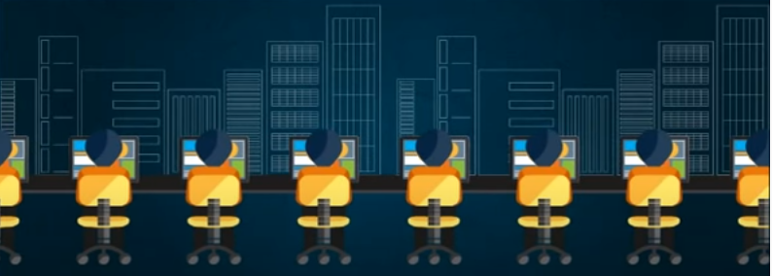
Fire Safety
Why is fire safety important?
Frame Type: <Animation>
Frame no.: <1-8>
Visulisation notes:
1. Show the employees in front od the systems nodding their heads
2. Show the movement of the chairs
Functionality instructions:
1. Synchronize the audio accordingly
2. Repeat the animation
<Content + Visual Area>
Notes:
Audio Notes: online courses cater to the needs of employees with different learning styles and preferences they can be accessed anytime anywhere by employees the content can be updated from time to time without much difficulty best of all assessments can be given at the end of the course to assess the extent to which employees understood safety aspects

Slide 11

Fire Safety
Why is fire safety important?
Frame Type: <Animation>
Frame no.: <1-9>
Visulisation notes:
1. Show the image with keyboard blinking
2. Click on image icons and numbers, should scroll on the screen
Functionality instructions:
1. Synchronize the audio accordingly
2. Repeat the animation
3. Lip movement for the character ram.
<Content + Visual Area>
Notes:
Audio Notes: To consider Learning what are the opportunities that it provides well to begin with we can use interactivities such as click on tabs click on images icons and numbers that propel employees to engage with the course secondly scenarios can be created using real-life situations to explain safe and unsafe practices these make better impact on employees than mere statements employees cannot simply go through the course without comprehending at the end of every module

Slide 12
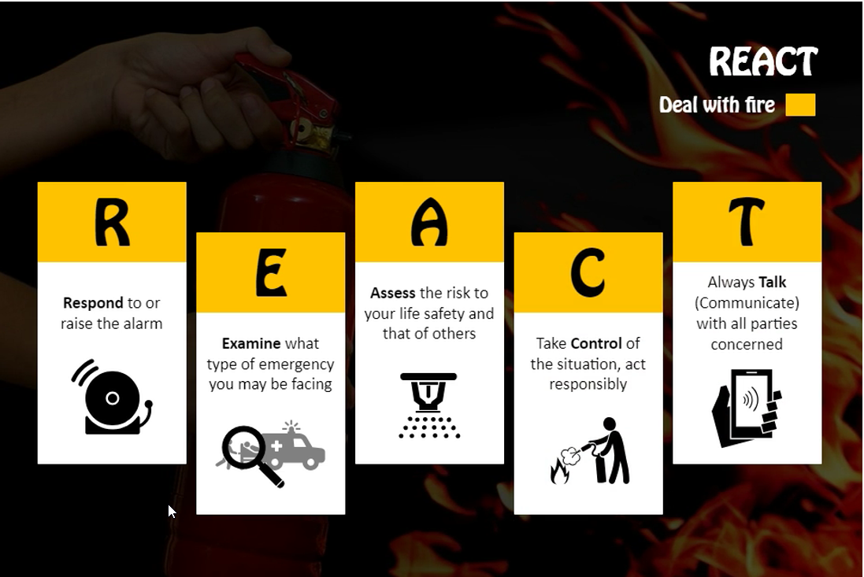
Fire Safety
Why is fire safety important?
Frame Type: <Animation>
Frame no.: <2>
Visulisation notes:
1. Show the image with icons blinking
2.
Functionality instructions:
1. Synchronize the audio accordingly
2.
<Content + Visual Area>
Notes:
Audio Notes: React: Deal with fire
Respond to or raise the alarm
Examine what type of emergency you may be facing
Assess the risk to your life safety and that of otheers
Take control od the situation, act responsibly
Always Talk with all parties concerned.

Slide 13

Fire Safety
Why is fire safety important?
Frame Type: <Animation/Interactive/Video>
Frame no.: <>
Visulisation notes:
1. . Show text (line-by-line) in sync with the audio.
2.
Functionality instructions:
1. Provide Click button to start to go for the next screen.
2. Open the assessment screen after clicking start button if not stay on the same screen.
This is a short assessment to see where you stand.
Read all the instructions carefully and click “start” button.
Instructions:
Do attempt all questions
Click submit to verify your answer
√ Indicates the correct answer
X indicates wrong answer
Click next to proceed to the next question
Click result to see your results
Good Luck
Notes:
<Audio Notes>Assessment
This is a short assessment to see where you stand.
Read all the instructions carefully and click “start” button.
Instructions:
Do attempt all questions
Click submit to verify your answer
√ Indicates the correct answer
X indicates wrong answer
Click next to proceed to the next question
Click result to see your results
Good Luck

Slide 14


Fire Safety
Why is fire safety important?
Frame Type: <Animation/Interactive/Video>
Frame no.: <>
Visulisation notes:
1. Show text (line-by-line) in sync with the audio.
2.
Functionality instructions:
1. Provide Click button to submit to go for the next screen.
2. If option wrong stay in the same screen.
Assessment
Read the question carefully and select the correct answer from the given options.
Leave the fire area immediately.
Activate the fire alarm and/or alert other staff.
If safe to do so, assist anyone in immediate danger.
Close all doors behind you to confine the fire.
Use exit stairwells to leave the building
True
False
√
Notes:
<Audio Notes> Read the question carefully and select the correct answer from the given options.
That`s correct , answer is true
Select the appropriate option and click on submit.
Click next to continue

Slide 15
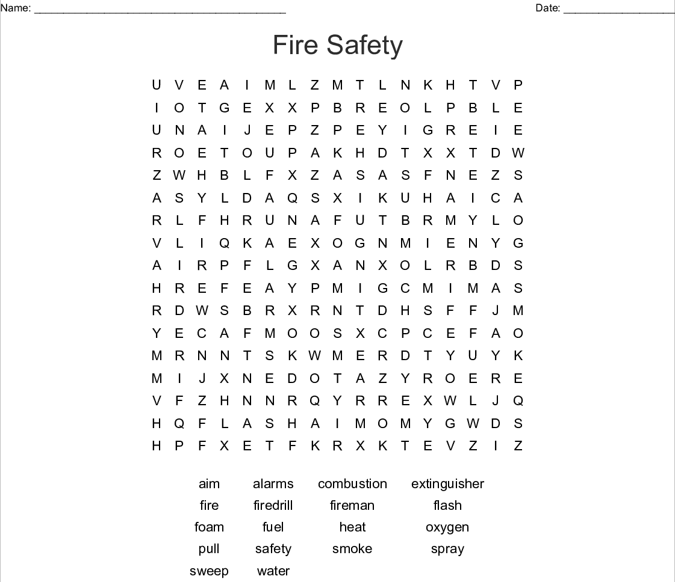
Fire Safety
Why is fire safety important?
Frame Type: <Animation/Interactive/Video>
Frame no.: <>
Visulisation notes:
1. Show text (line-by-line) in sync with the audio.
2.
Functionality instructions:
1. Provide Click button to submit to go for the next screen.
2. If option wrong stay in the same screen.
Scenario
What could Mark have done differently to prevent the accident?
Select the correct and click submit.
Notes:
<Audio Notes> Self-Evaluation
Hi _______!
Take this questionnaire to check where you stand at the end of the module. It will give you an idea of how your skills have improved.
On the right, there is a scenarios. Based on the scenario, select the most appropriate answer.
Your answer will not be recorded or shared with anyone.

Slide 16
Manual Handling
ManualHandling Training
Frame Type: <Animation>
Frame no.: <0>
Visulisation notes:
1. Show the button
2.
Functionality instructions:
1. Provide Click button on module
2.
Module on Manual Handling

Slide 17
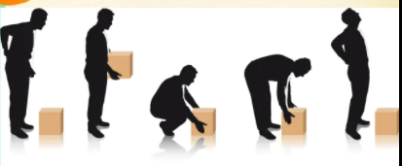
Manual Handling
ManualHandling Training
Frame Type: <Interactive>
Frame no.: <>
Visulisation notes:
1.
2.
Functionality instructions:
1.
2.
Notes:
Audio Notes: Click on the module to know more

